Slide 1
Data Structure and Algorithms
(CS212)
Instructor : Syed Musharaf Ali
ROOM G-104-DSE IIUI
Ph# 051-9019724 Ext-2724
Email: musharaf.ali@iiu.edu.pk

Slide 2
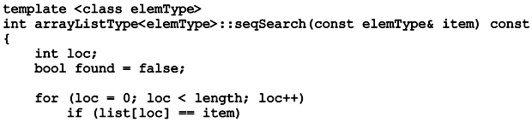
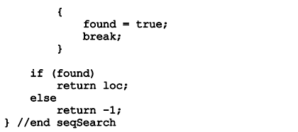
Linear Search Algorithm
In this type of search, a sequential search is made over all items one by one.
Every item is checked and if a match is found then that particular item is returned, otherwise the search continues till the end of the data collection.

Slide 3
Linear Search Algorithm
Linear search algorithm finds given element in a list of elements with O(n) time complexity where n is total number of elements in the list

Slide 4
Binary Search Algorithm
Binary search algorithm finds given element in a list of elements with O(log n) time complexity where n is total number of elements in the list.
The binary search algorithm can be used with only sorted list of element.
This search process starts comparing of the search element with the middle element in the list. If both are matched, then the result is "element found“
Otherwise, we check whether the search element is smaller or larger than the middle element in the list.

Slide 5
Binary Search Algorithm
If the search element is smaller, then we repeat the same process for left sub list of the middle element.
If the search element is larger, then we repeat the same process for right sub list of the middle element.
We repeat this process until we find the search element in the list or until we left with a sub list of only one element.
And if that element also doesn't match with the search element, then the result is "Element not found in the list".

Slide 6
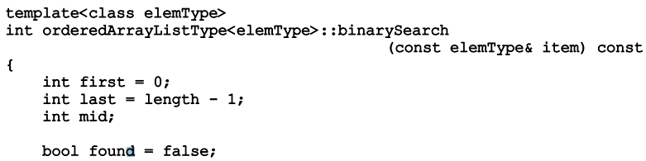
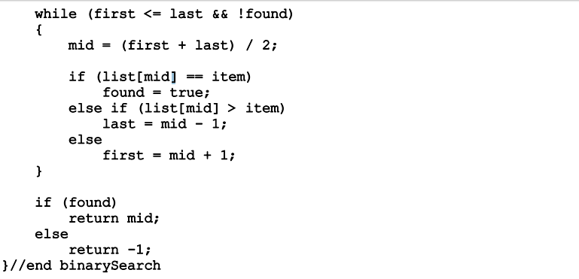
Binary Search Algorithm

Slide 7
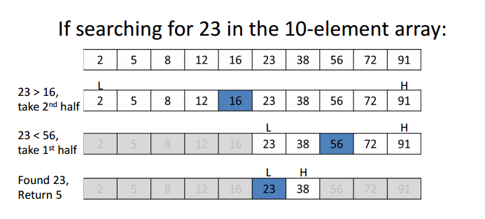
Binary Search Algorithm
Example 1:
Time complexity of binary search is O(logn)

Slide 8
Interpolation Search Algorithm
The Interpolation Search is an improvement over Binary search for instances, where the values in a sorted array are uniformly distributed.
Binary Search always goes to middle element to check. On the other hand interpolation search may go to different locations according the value of key being searched.
For example if the value of key is closer to the last element, interpolation search is likely to start search toward the end side.
http://www.geeksforgeeks.org/interpolation-search/

Slide 9
Interpolation Search Algorithm
To find the position to be searched, it uses following formula.
pos = lo + [ (x-arr[lo])*(hi-lo) / (arr[hi]-arr[Lo]) ]
arr[] ==> Array where elements need to be searched
x ==> Element to be searched
lo ==> Starting index in arr[]
hi ==> Ending index in arr[]
Algorithm
Rest of the Interpolation algorithm is same except the above partition logic.
Step1: In a loop, calculate the value of “pos” using the probe position formula.
Step2: If it is a match, return the index of the item, and exit.
Step3: If the item is less than arr[pos], calculate the probe position of the left sub-array. Otherwise calculate the same in the right sub-array.
Step4: Repeat until a match is found or the sub-array reduces to zero.

Slide 10
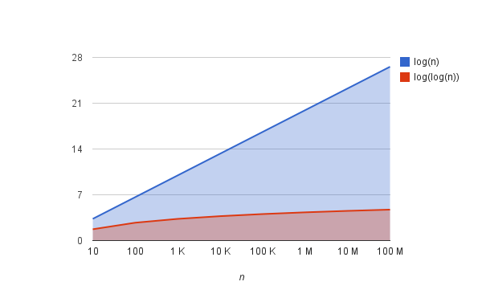
Interpolation Search Algorithm
The complexity of this algorithm is log₂(log₂(n))
log₂(log₂(100 M)) ≈ 4.73 !!!

